Slide 1
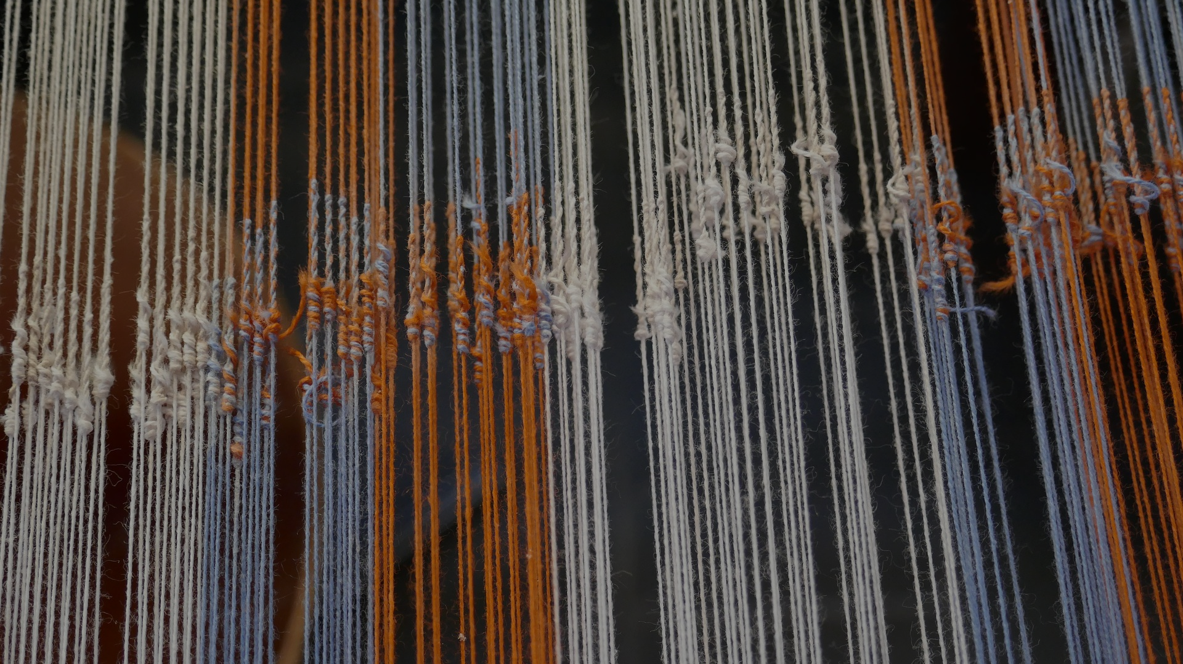
WRITING THE TOK ESSAY PLAN
BQ3 Spin Lesson 4
I understand how to write my TOK essay plan, and how it will be assessed
Notes:
See how this lesson links to the course by viewing the final slide
Key TOK terms appear in a red font

Slide 2
Starter
Make sure you have found the two key documents on Google Classroom for understanding the TOK essay plan:
Rubric and Instructions doc
The exemplar TOK essay plan
Notes:
Rubric and instructions link also here.
Exemplar essay plan also here.

Slide 3
Step 1: breaking the ice
Read through the rubric & instructions.
Don’t follow any of the links yet.

Slide 4
Step 2: the big picture
Make a copy of the exemplar TOK essay plan document.
Highlight the following sections:
Introduction
Discussion 1 (argument & counter-argument)
Discussion 2 (argument & counter-argument)
Challenge to the question
Conclusion

Slide 5
Step 3: Close reading
Now locate and label the following elements of the essay plan:
The ‘hook’
Key words that have been explained
The areas of knowledge identified
Outline of the arguments and counter-arguments
Key thinkers mentioned
Real-life situations used to justify points
The answer to the question
Notes:
Now submit your copy of the essay plan...

Slide 6
Step 4: getting started
Look at the titles, and decide which one you will write. We have linked the titles to the BQs - this may help you decide.
Try to choose one that interests you, and which you feel you can answer without
‘sitting on the fence’
Decide on the two areas of knowledge you will explore in your essay plan.
Look through the key thinkers we have considered so far during the course
Think of any real life situations that might work in your essay plan
Notes:
More ambitious students may wish to do a title that links to a BQ that you haven’t already done.
Less ambitious students will probably want to stick with one that links to BQs 1, 2, and 3.

Slide 7
Support
You will be writing the essay plan on your own.
However, we will offer ‘drop-in clinics’ for you to seek support.
You can also share your ideas with us as you create them, and we’ll give you feedback.
Notes:
Optional slide - if you are offering drop-in clinics (either online or in-person).

Slide 8
Add a comment (questions or concerns you may still have, impressions of writing the TOK essay, etc.) to the shared ‘TOK essay plan comments’ doc (on Classroom).
We will do our best to resolve any problems you have, by adding a response.
Notes:
Add a document to Google Classroom for students to post their comments. Respond as quickly as you can to ensure they know where they’re going from the start
Here is a sample TOK essay plan FAQs created from a doc of this kind
See the BQ3 assessment tracker for suggestions on providing feedback, and recording students’ progress

Slide 9
Explore the TOK themes and areas of knowledge in more depth via a range of thinkers, media sources, and other resources, in our EXPLORATION POINTS DOCUMENTS.
Access the documents via the links below. You’ll also find the EP icons on all of the TOK course pages of the site to help you unpack the quotes, KQs, and real-life situations that you find there.
CORE THEME
Knowledge & the knower
OPTIONAL THEMES
Indigenous societies
Language
Politics
Religion
Technology
AREAS OF KNOWLEDGE
The arts
History
Human sciences
Mathematics
Natural sciences
Notes:
Use this slide to access the ‘Exploration Points’ notes for BQ3, which will help students to develop a deeper knowledge of any TOK theme or area of knowledge. This will not only help them to master the TOK course in general, but also craft a great exhibition or essay.
Be ready to provide more guidance on how to use this resource - ie, which media sources to focus on, which questions to address, which TED talks to watch, and which key terms and ideas to understand.

